Slide 1
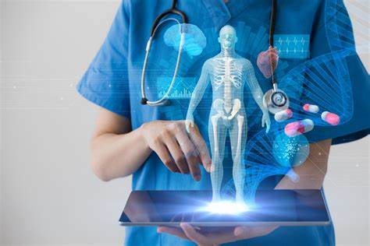
Faster and more accurate Skin Cancer Identification
By Victoria Vicheva 233182

Slide 2
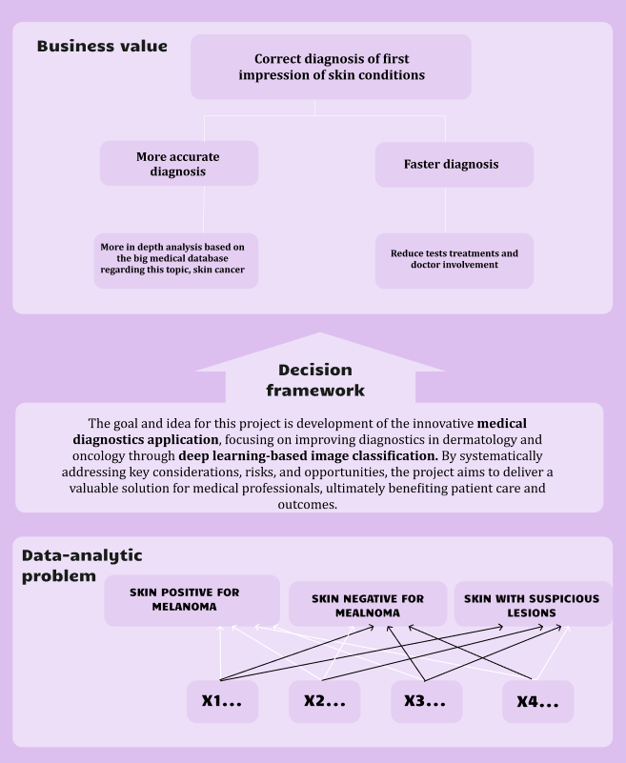
Project Pitch
Business Understanding
First idea:
Faster and more accurate diagnosis of skin cancer, type Melanoma and other skin types of skin lesions
Main stakeholder:
Medical organizations such as hospitals and clinics
Application idea:
Diagnosis in a snap
Fig.1: DAPS Diagram

Slide 3
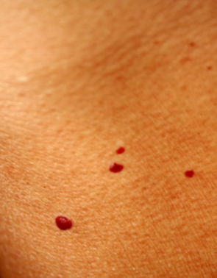
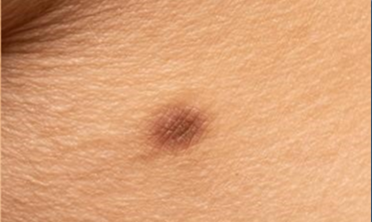
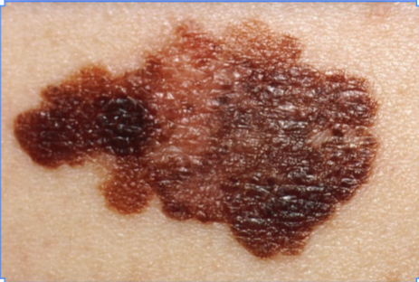
Problem Overview
Fig.2: Cherry angioma
Fig.1: Benign mole
Deep Learning
What will this model predict?
Successful identification of
skin cancer, type Melanoma.
How many classes are in the dataset?
“Skin with benign(non-cancerous) moles”
“Skin with suspicious lesions”
“Skin with Melanoma”
In each class:
200 images, in total there are 600 image in the dataset
Accuracy of Baselines:
Random Guess: around 33%
Human-Level Performance: 30-40%
Basic MLP: around 70%
Fig.3:Melanoma

Slide 4
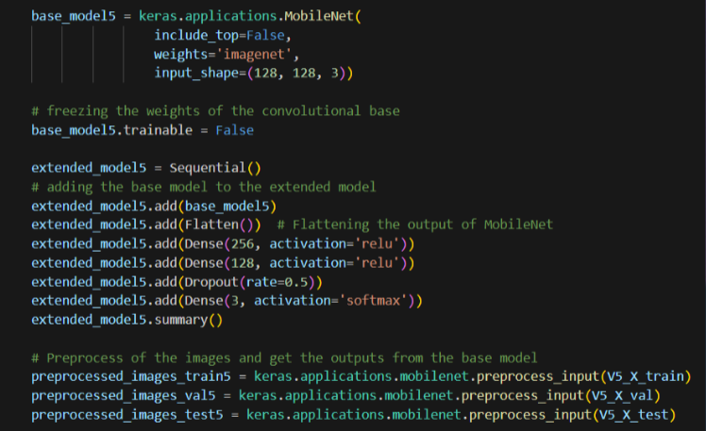
Model Overview
Deep Learning
The process of creating and training the model:
Iteration 1: manually preprocessing + one-hot encoding
Iteration 2: Resizing + one-hot encoding
Iteration 3: Data Augmentation
Iteration 4: Transfer Learning, Xception model + Data Augmentation
Iteration 5: Transfer Learning, MobileNet

Slide 5
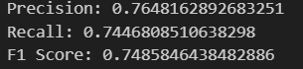
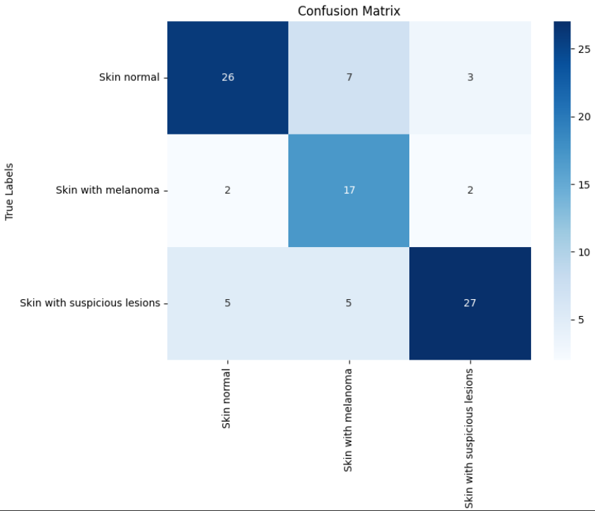
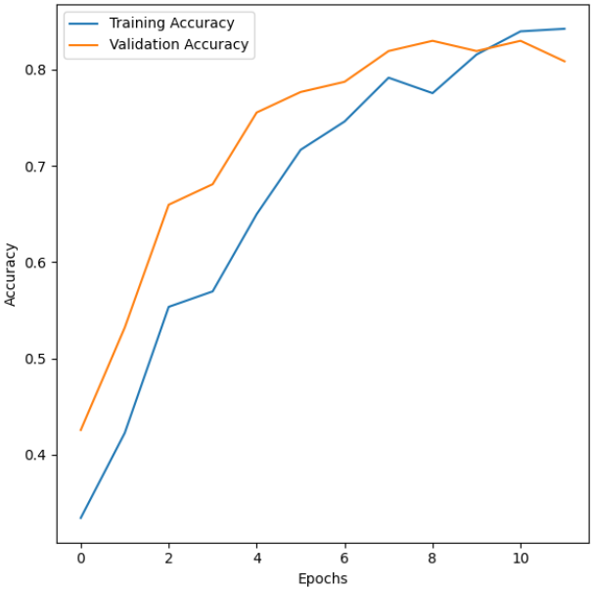
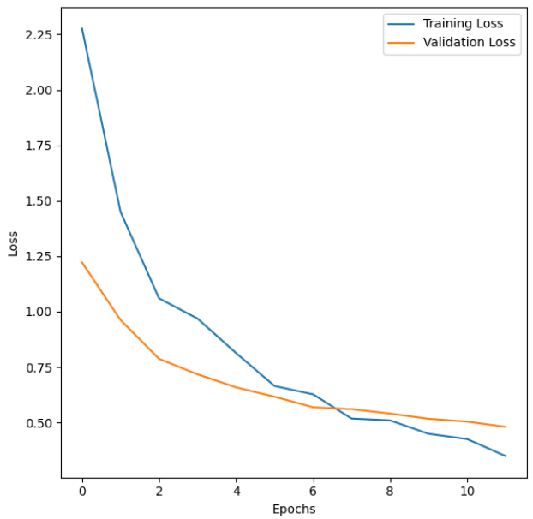
Model Performance
Deep Learning
Results obtained with the final version of the model:
Final version:
Iteration5 Transfer Learning, MobileNet
75% Test Accuracy

Slide 6
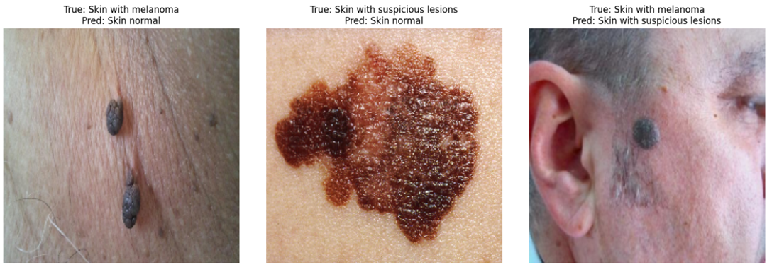
Demo
Human-Centered AI
.
Some results from the error analysis

Slide 7
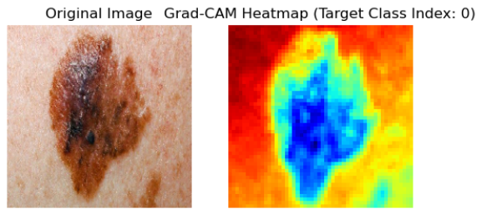
Model Interpretability
Responsible AI (1)
In the context of a medical image classifier for skin lesion detection, interpretability holds greater importance.
Example XAI methods:
Saliency
DeconcNet
Gradient Input
Guided Backpropagation
Grad-CAM
Fig

Slide 8
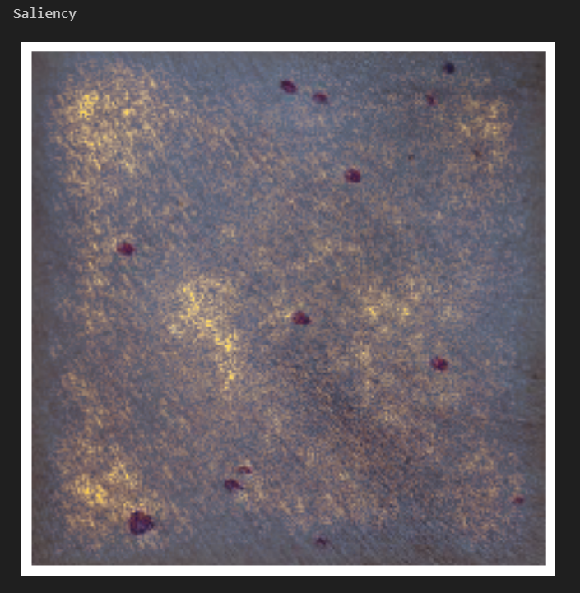
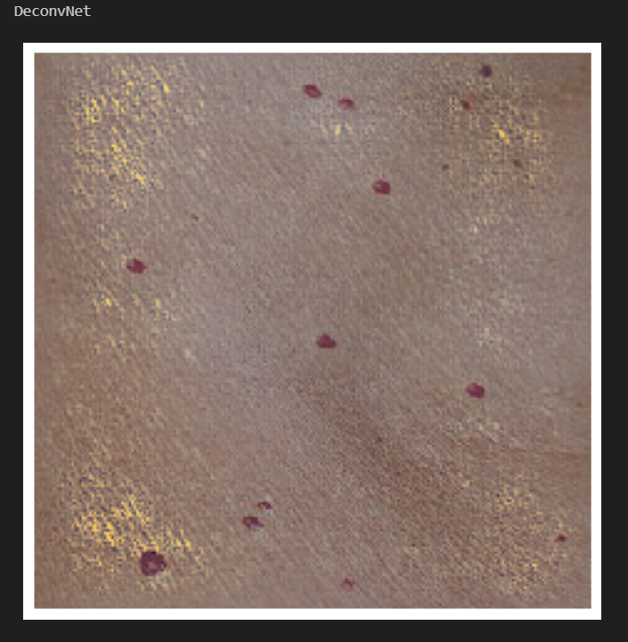
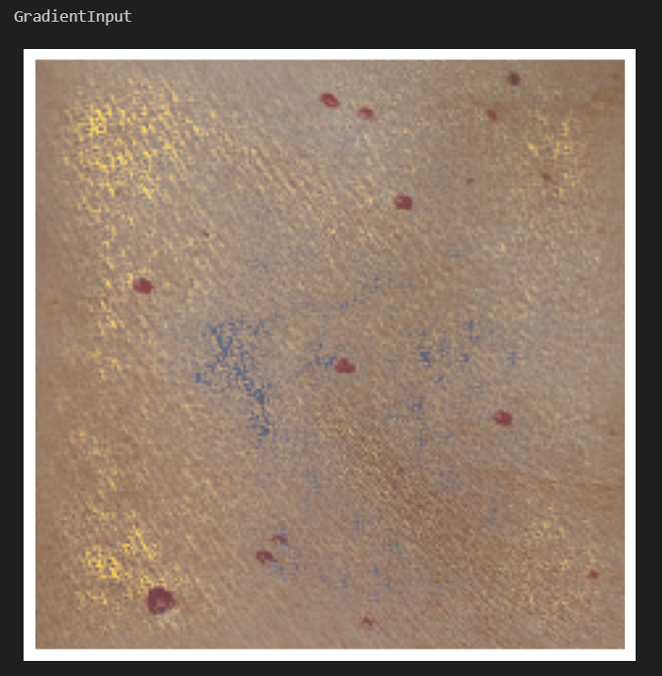
.
Responsible AI(2)
.
Other XAI methods

Slide 9
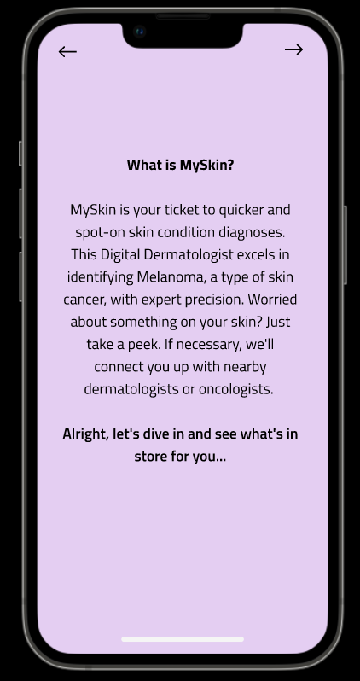
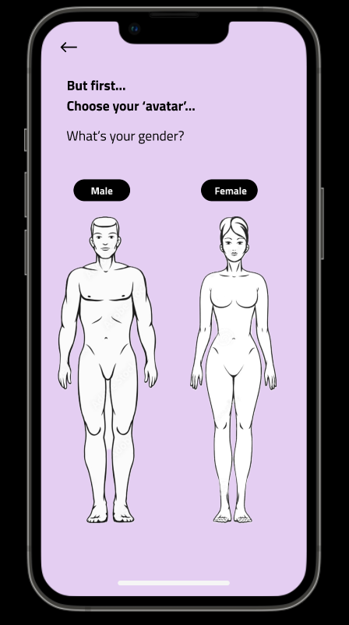
User Study
Human-Centered AI
Results of think-aloud study:
- Mostly positive
Users knew what to do
Confusion with the buttons
A/B test:
Both positive and negative feedback
Most of the testers did not understand
the exact purpose of the application

Slide 10
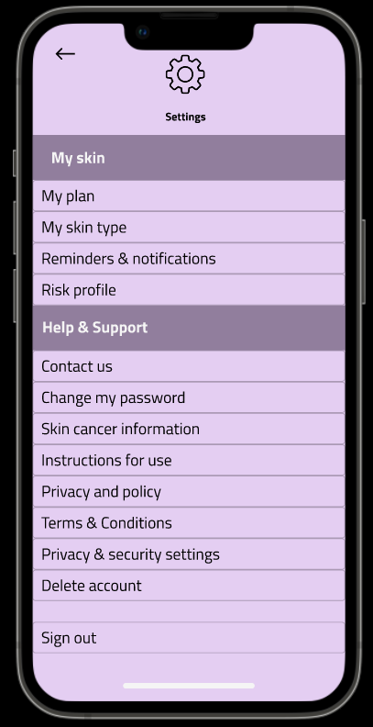
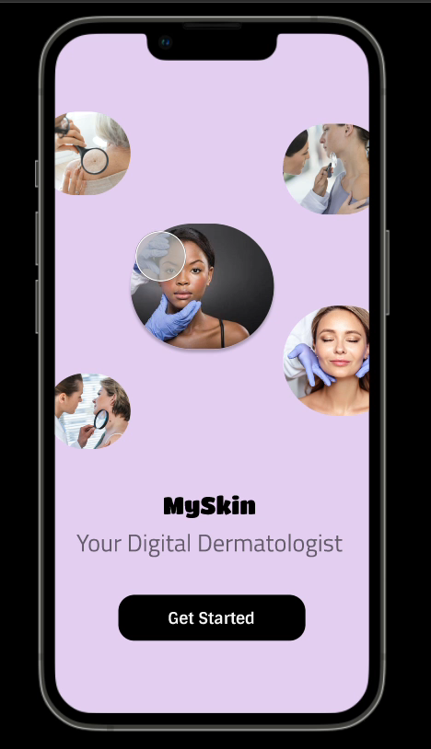
Demo
Human-Centered AI
.

Slide 11
Thank you for your attention!
Any questions?

